Slide 1







Horses for courses The Game
Statistics is not about memorising tests. It’s about recognising structure.
Notes:
“Today is our final tutorial of the year, and instead of introducing something new, we’re going to step back and look at everything you’ve learned.
Over the past weeks, you’ve met a lot of tools — t-tests, chi-square tests, ANOVA, binomial probabilities, conditional probability, odds ratios… It can sometimes feel like a toolbox that just keeps getting bigger.
But here’s the important thing: statistics is not about memorising tools.
It’s about knowing which tool fits which question.
That’s what today’s game — Horses for Courses — is about.
Each statistical method is like a horse. Each research question is a course. Not every horse belongs on every course.
Your challenge is to:
Read each case carefully
Identify the structure of the data
Decide whether you’re calculating a probability or analysing data
Match the correct tool
And choose the most appropriate visualisation
Some of the cards you’re holding won’t belong to your own cases. So you’ll need to read the board, think carefully, and justify your reasoning.
This isn’t about speed. It’s about thinking clearly.
By the end of today, you should feel more confident answering the most important statistical question of all:
‘Which method should I use — and why?’”

Slide 2
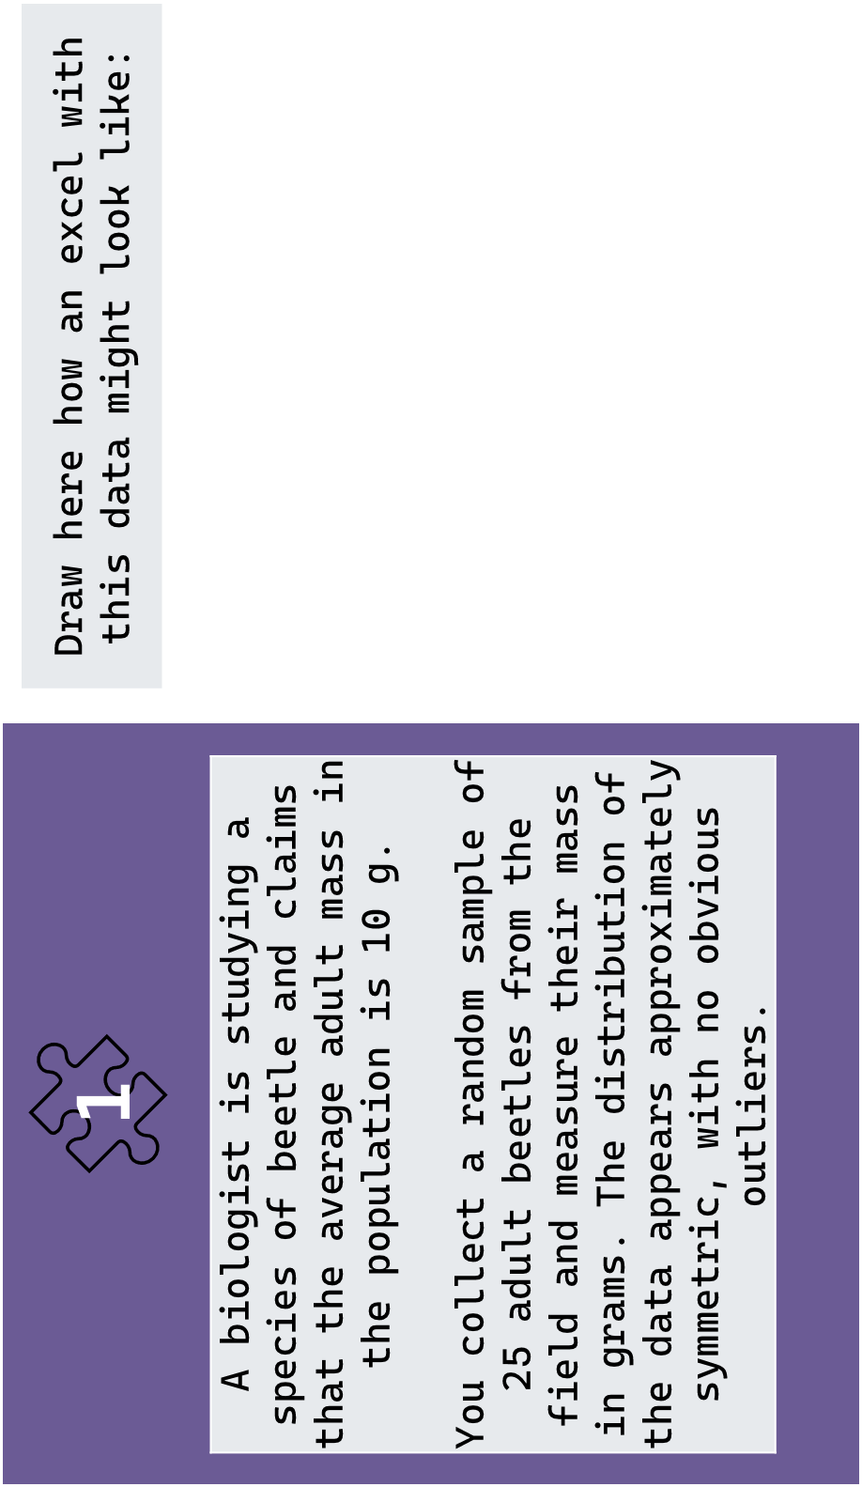
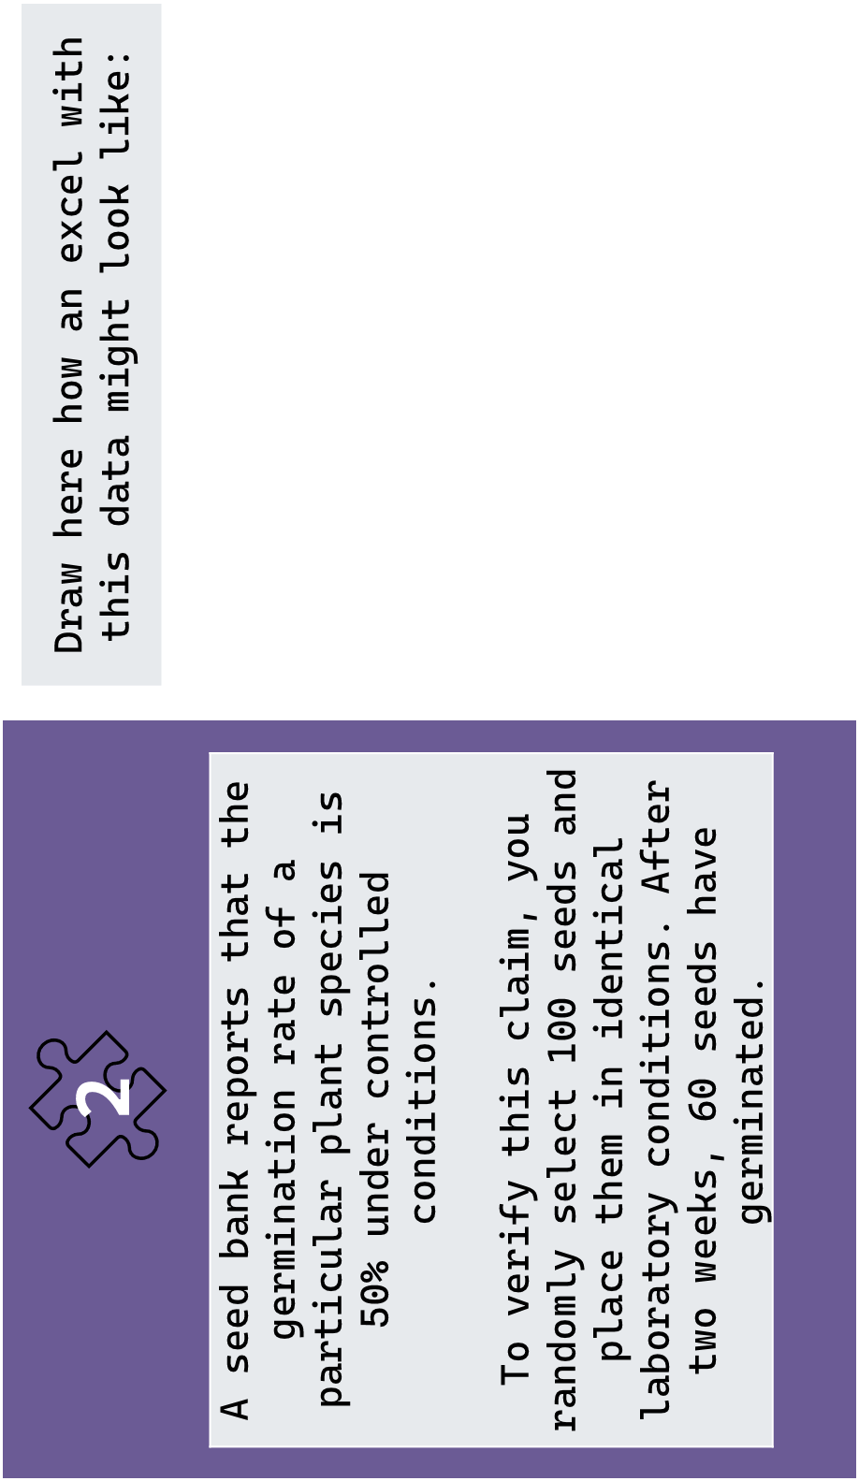

Slide 3
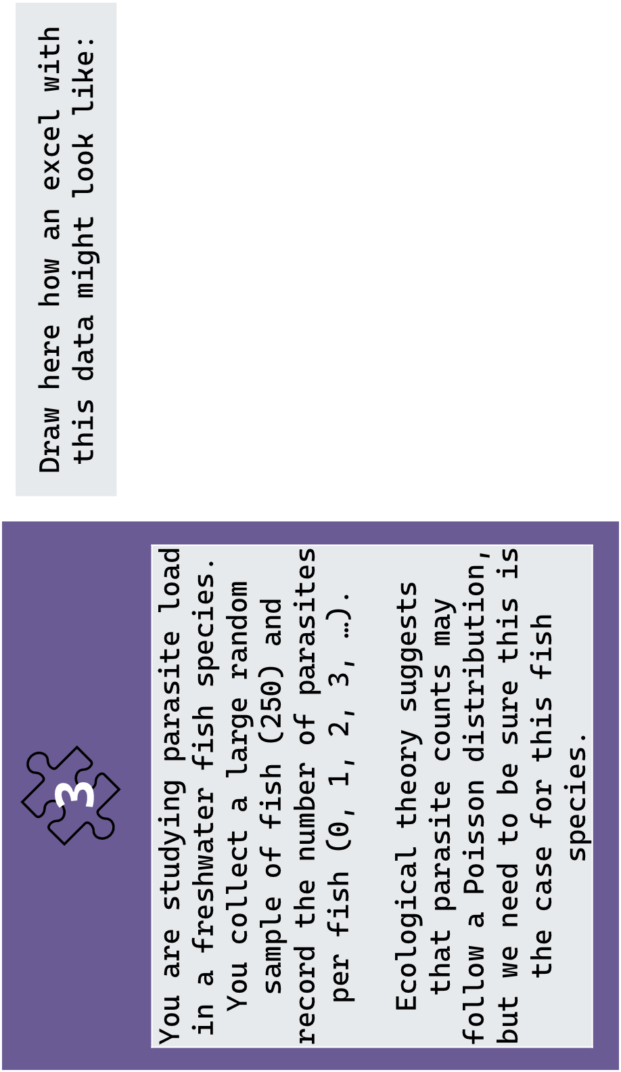
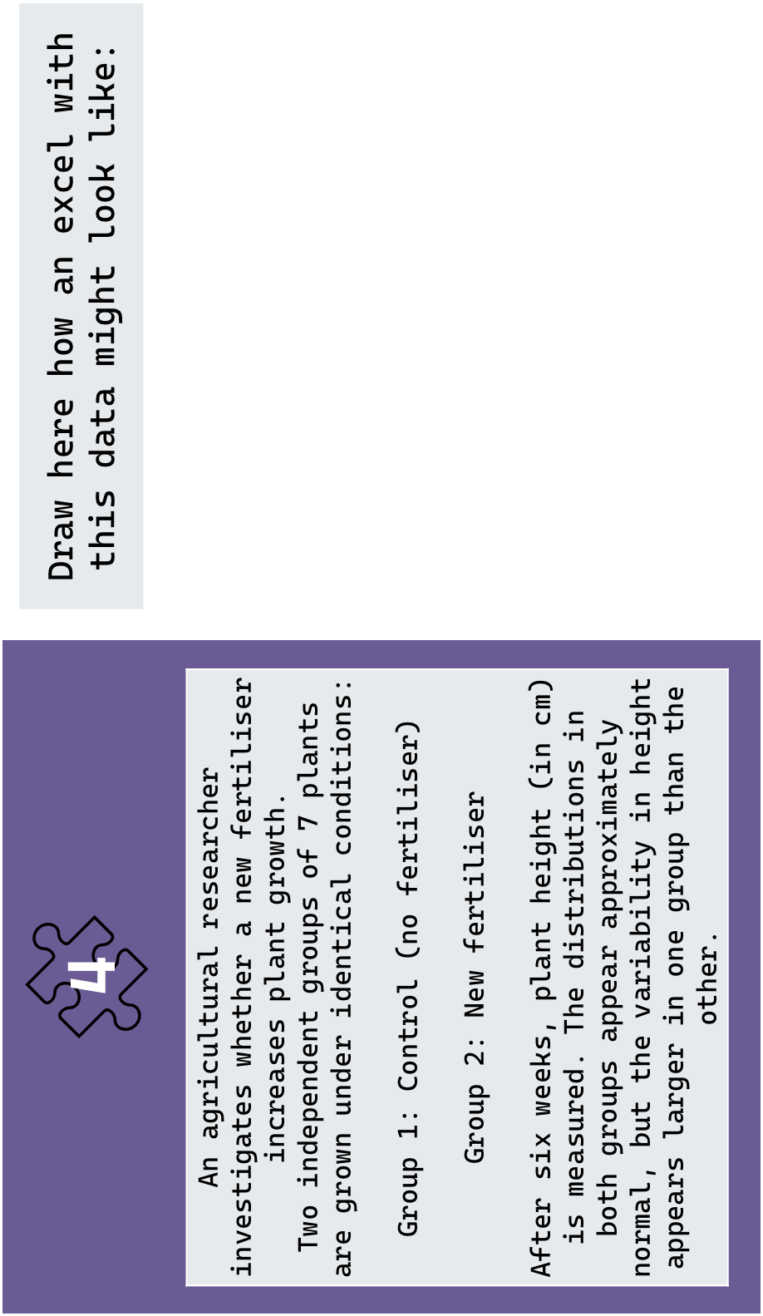

Slide 4
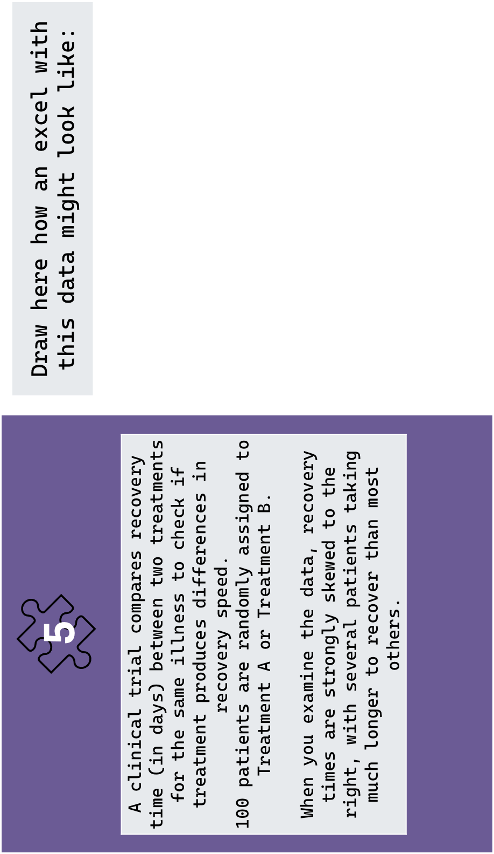
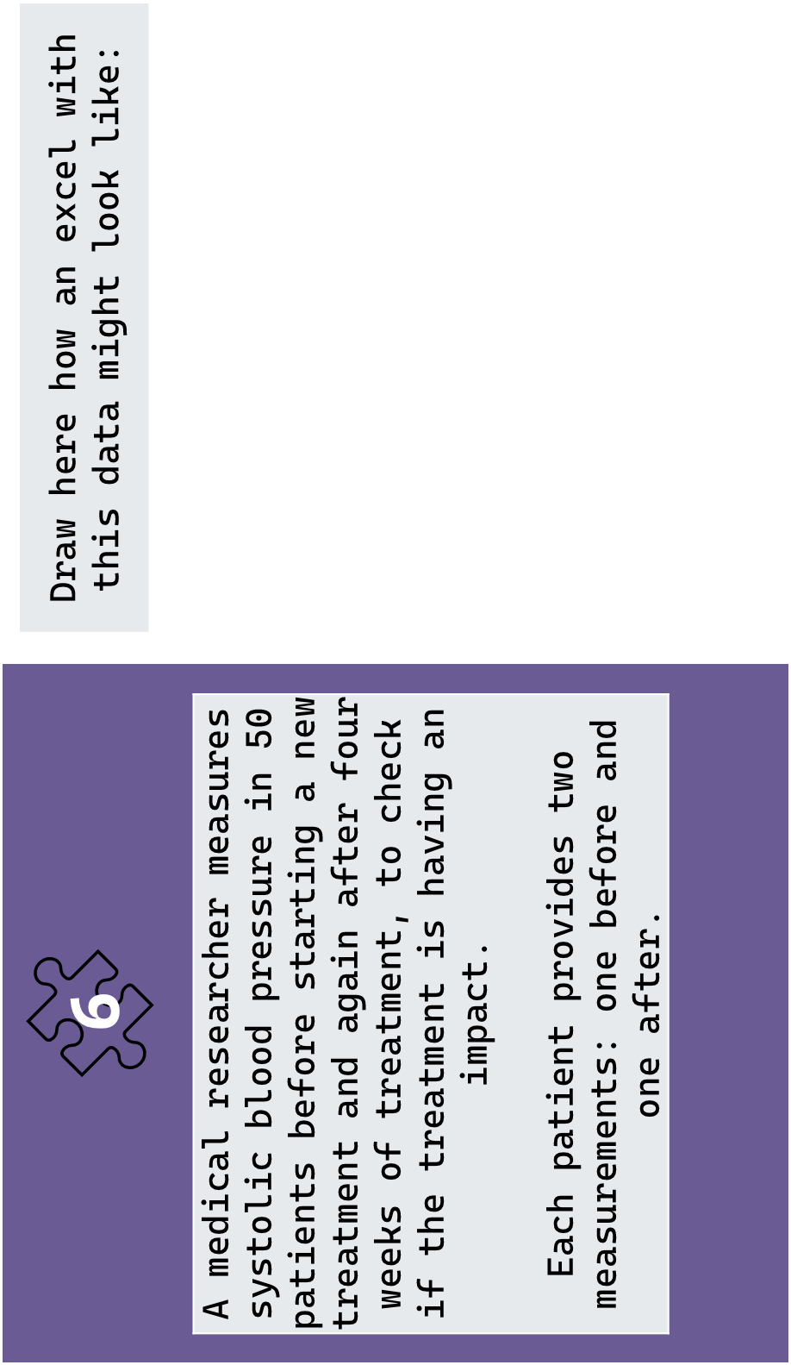

Slide 5
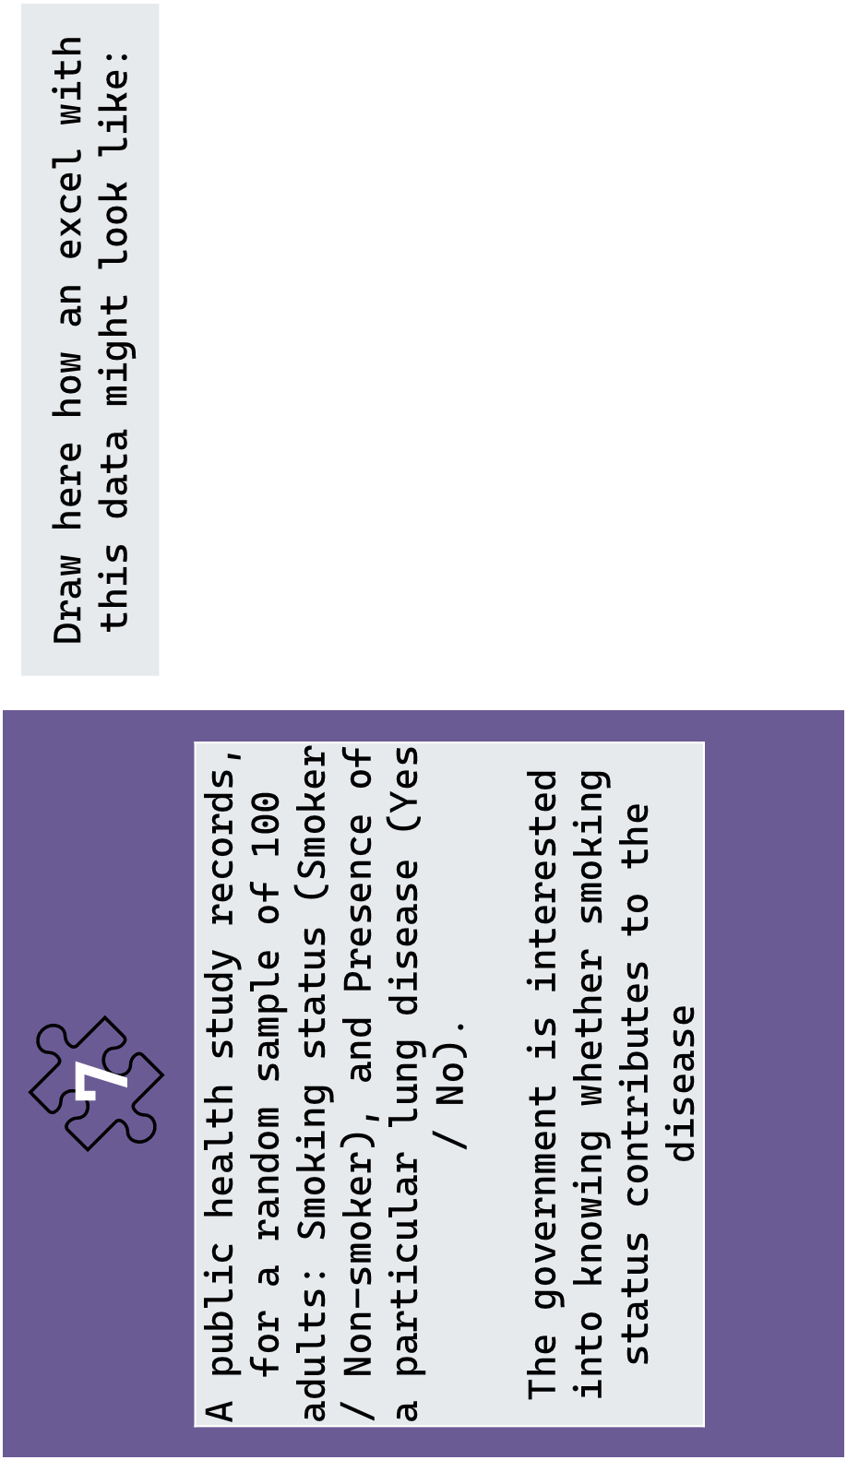
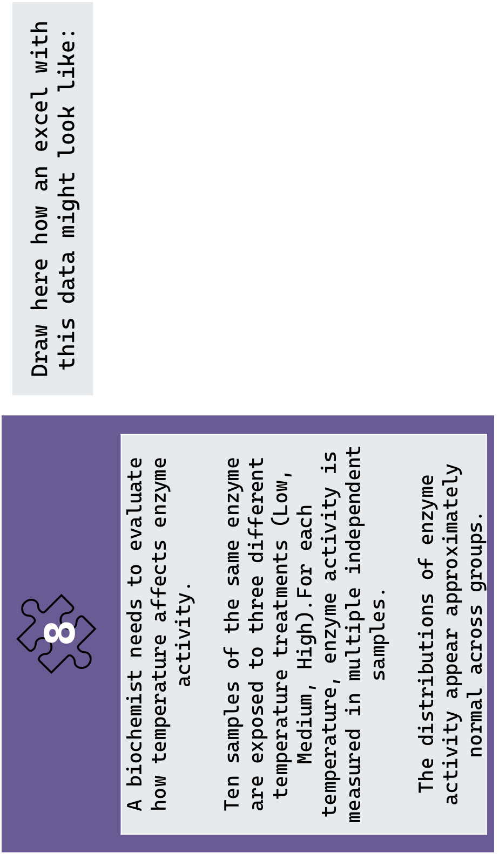

Slide 6
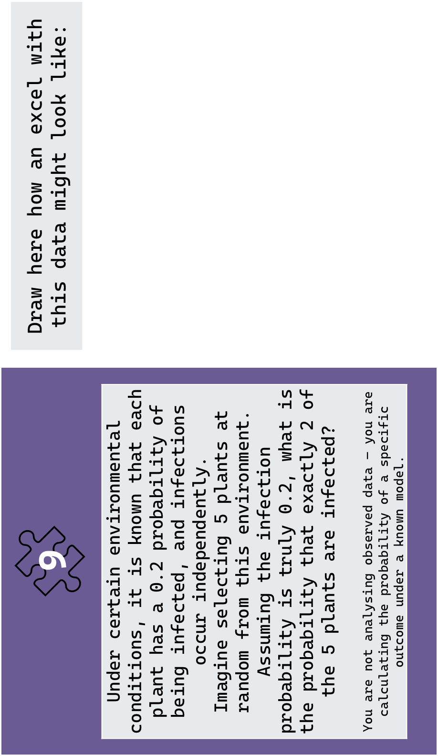

Notes:
Note that the question here is What is the probability exactly 2 of 5 plants are infected if p = 0.2? And NOT: You observe 2 infected out of 5. Is this evidence that p ≠ 0.2?

Slide 7
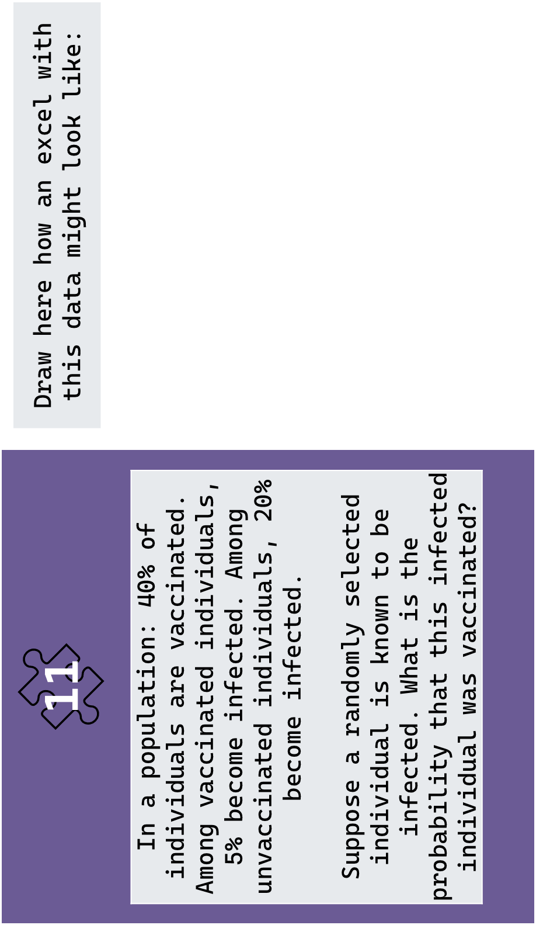
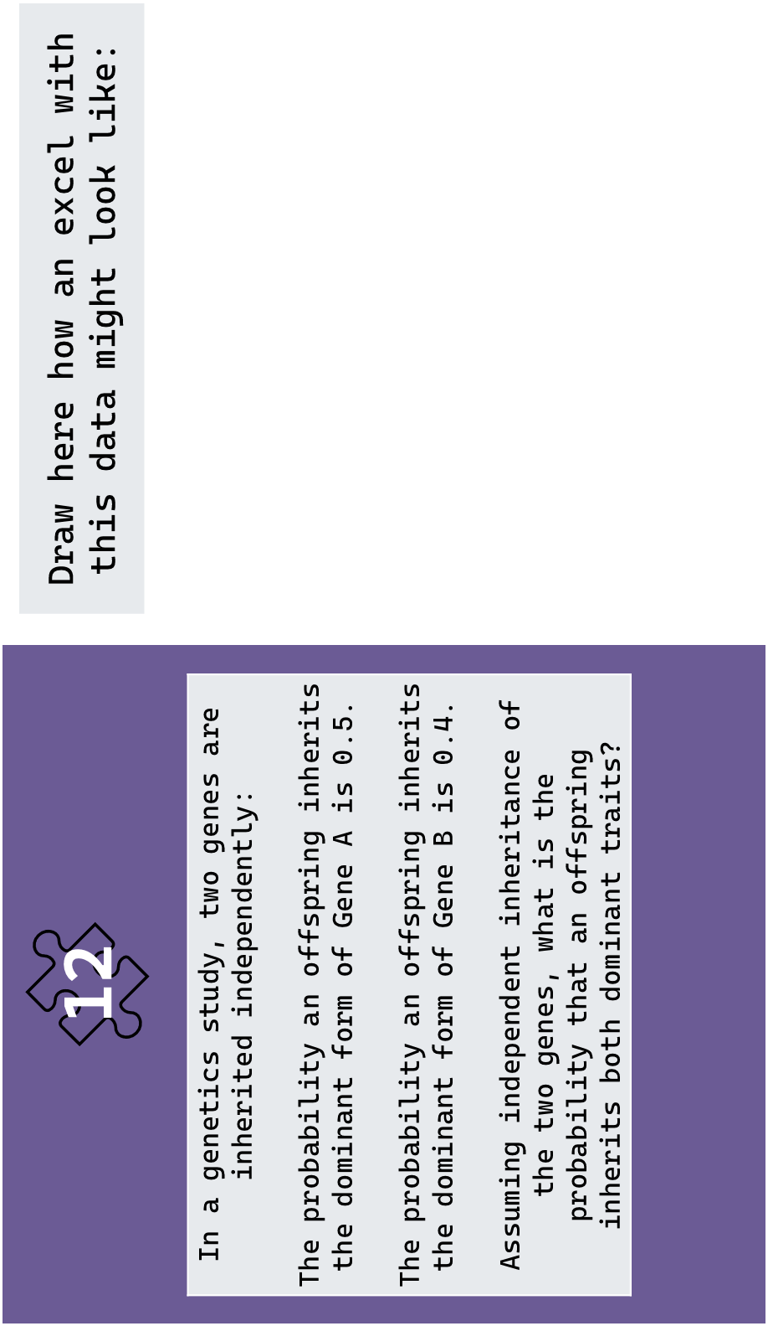

Slide 8
Draw here how an excel with this data might look like:
13
A plant disease is believed to infect plants with probability 0.5 under certain conditions. You examine a small sample of 10 plants and observe that 8 are infected. Assuming the true infection probability is 0.5, what is the probability of observing 8 or more infected plants out of 10?

Slide 9

One sample t-test
χ² goodness-of-fit
Binomial test (χ² GOF for large n)
Welch’s t-test

Slide 10
Mann–Whitney U
χ² test of independence + OR/RR
Paired t-test (Sign test if non-normal)
ANOVA / Linear Model (Kruskal–Wallis if non-normal)

Slide 11
Binomial formula exact probability
Conditional probability
Simple addition combined probability
Product rule joint probability

Slide 12
Bar plot
Violin plot
Histogram including mean and CI
Rootogram

Slide 13
Paired dot plot
Boxplot
Mosaic plot
Bar plot with error bars

Slide 14
Probability mass plot
Tree diagram or mosaic plot
Pie or bar plot
Tree or Venn diagram

Slide 15
CASE

Slide 16
RESEARCH QUESTION

Slide 17
DATA STRUCTURE ne variable / Two variables; Numerical or Categorical; Independent or Paired; # Groups

Slide 18
KEY ASSUMPTION

Slide 19
STATISTICAL METHOD

Slide 20
CASE

Slide 21
VISUALISATION (add a little drawing)

Slide 22
WHAT ARE WE CALCULATING?

Slide 23
DATA DESCRIPTION Categories, events, mutually exclusive or not

Slide 24
RULE / DISTRIUBTION Addition, multiplication, conditional, binomial

Slide 25
VISUALISATION (add a little drawing)

Slide 26
SOLUTIONS
Case | Research question | Data structure (One variable / Two variables; Numerical or Categorical; Independent or Paired; # Groups) | Key assumption | Statistical method | Visualisation
1 | Is mean mass different from 10 g? | One variable; Numerical; One sample | Approx. normal | One-sample t-test | Histogram + mean & CI
2 | Is germination rate different from 50%? | One variable; Categorical (success/failure); One sample | Independent trials; binomial setting | Binomial test | Bar plot (proportion)
3 | Do parasite counts follow a Poisson distribution? | One variable; Categorical (counts in categories) | Expected frequencies adequate | Chi-square goodness-of-fit | Observed vs expected bar plot
4 | Do treatments differ in mean height? | Two variables; Numerical response; Categorical explanatory (2 groups); Independent | Approx. normal; unequal variance | Welch’s t-test | Boxplot (2 groups)
5 | Do treatments differ in recovery time? | Two variables; Numerical response; Categorical explanatory (2 groups); Independent | Non-normal distribution | Mann–Whitney U | Boxplot / violin
6 | Does treatment change blood pressure? | Two variables; Numerical response; Paired measurements | Approx. normal differences | Paired t-test (Sign test if non-normal) | Paired dot plot
7 | Is disease associated with smoking? | Two variables; Both categorical; Independent; 2×2 table | Expected counts adequate | Chi-square independence (+ OR/RR) | Mosaic plot
8 | Do means differ among temperatures? | Two variables; Numerical response; Categorical explanatory (>2 groups); Independent | Approx. normal | ANOVA (Kruskal–Wallis if non-normal) | Bar plot with error bars
Case | What are we calculating? | Describe the situation (categories, events, mutually exclusive or not) | Rule / Distribution to use | Visual representation
9 | Probability that exactly 2 out of 5 plants are infected | Repeated independent trials; fixed number of trials (5); two outcomes per trial (infected / not infected); same probability each time | Binomial distribution (exact probability) | Probability mass function (bar plot of binomial probabilities)
10 | Probability the bird eats insects OR fruit | Single event with multiple categories; categories are mutually exclusive (only one food type per feeding event) | Addition rule (for mutually exclusive events) | Bar chart or simple categorical diagram
11 | Probability an infected individual was vaccinated (P(Vaccinated | Infected)) | Two related events; not mutually exclusive; conditional relationship; requires reversing conditioning | Conditional probability (Probability tree / Bayes reasoning) | Probability tree diagram
12 | Probability offspring has both dominant traits (A AND B) | Two separate events; events are independent; joint occurrence required | Multiplication rule (independent events) | Tree diagram showing branches multiplied

Slide 27
SOLUTIONS
Case | Research question | Data structure (One variable / Two variables; Numerical or Categorical; Independent or Paired; # Groups) | Key assumption | Statistical method | Visualisation
1 | Is mean mass different from 10 g? | One variable; Numerical; One sample | Approx. normal | One-sample t-test | Histogram + mean & CI
2 | Is germination rate different from 50%? | One variable; Categorical (success/failure); One sample | Independent trials; binomial setting | Binomial test | Bar plot (proportion)
3 | Do parasite counts follow a Poisson distribution? | One variable; Categorical (counts in categories) | Expected frequencies adequate | Chi-square goodness-of-fit | Observed vs expected bar plot
4 | Do treatments differ in mean height? | Two variables; Numerical response; Categorical explanatory (2 groups); Independent | Approx. normal; unequal variance | Welch’s t-test | Boxplot (2 groups)
5 | Do treatments differ in recovery time? | Two variables; Numerical response; Categorical explanatory (2 groups); Independent | Non-normal distribution | Mann–Whitney U | Boxplot / violin
6 | Does treatment change blood pressure? | Two variables; Numerical response; Paired measurements | Approx. normal differences | Paired t-test (Sign test if non-normal) | Paired dot plot
7 | Is disease associated with smoking? | Two variables; Both categorical; Independent; 2×2 table | Expected counts adequate | Chi-square independence (+ OR/RR) | Mosaic plot
8 | Do means differ among temperatures? | Two variables; Numerical response; Categorical explanatory (>2 groups); Independent | Approx. normal | ANOVA (Kruskal–Wallis if non-normal) | Bar plot with error bars
Case | What are we calculating? | Describe the situation (categories, events, mutually exclusive or not) | Rule / Distribution to use | Visual representation
9 | Probability that exactly 2 out of 5 plants are infected | Repeated independent trials; fixed number of trials (5); two outcomes per trial (infected / not infected); same probability each time | Binomial distribution (exact probability) | Probability mass function (bar plot of binomial probabilities)
10 | Probability the bird eats insects OR fruit | Single event with multiple categories; categories are mutually exclusive (only one food type per feeding event) | Addition rule (for mutually exclusive events) | Bar chart or simple categorical diagram
11 | Probability an infected individual was vaccinated (P(Vaccinated | Infected)) | Two related events; not mutually exclusive; conditional relationship; requires reversing conditioning | Conditional probability (Probability tree / Bayes reasoning) | Probability tree diagram
12 | Probability offspring has both dominant traits (A AND B) | Two separate events; events are independent; joint occurrence required | Multiplication rule (independent events) | Tree diagram showing branches multiplied

Slide 28
🟢 GROUP 2
Cases: 2 (Binomial test) 4 (Welch t-test) 10 (Addition rule probability)
Tools: 2 (Binomial test) ✅ matches Case 2 8 (ANOVA) 12 (Multiplication rule)
Visualisations: 2 (Bar plot proportion) ✅ matches Case 2 4 (Boxplot 2 groups) 12 (Tree diagram independent)
They can correctly solve Case 2 themselves. Must read board for:
Welch t-test
Addition rule
🔴 GROUP 4
Cases: 5 (Mann–Whitney) 8 (ANOVA) 12 (Multiplication rule probability)
Tools: 4 (Welch t-test) 7 (Chi-square independence) 10 (Addition rule)
Visualisations: 5 (Boxplot skewed) 8 (Boxplot >2 groups) 9 (Binomial PMF)
This group initially has ZERO direct matches. They must rely entirely on reasoning + checking other groups.
This creates asymmetry — which is good.
🔵 GROUP 1
Cases: 1 (One-sample t-test) 7 (Chi-square independence) 9 (Binomial probability)
Tools: 1 (One-sample t-test) ✅ matches Case 1 5 (Mann–Whitney) 11 (Probability tree)
Visualisations: 1 (Histogram + CI) ✅ matches Case 1 7 (Mosaic plot) 10 (Bar/pie chart)
They can correctly solve Case 1 themselves. They must look at the board to place:
Mosaic plot
Probability tree
Mann–Whitney
🟡 GROUP 3
Cases: 3 (Chi-square GOF) 6 (Paired t-test) 11 (Conditional probability)
Tools: 6 (Paired t-test) ✅ matches Case 6 3 (Chi-square GOF) 9 (Binomial formula)
Visualisations: 6 (Paired dot plot) ✅ matches Case 6 3 (Observed vs expected bars) 11 (Probability tree)
They can correctly solve Case 6. But they have correct tool for Case 3 — so that’s interesting: They’ll realise they can solve two of their own cases. Still must read board for conditional probability.
Elements to deliver to each group:

Slide 29
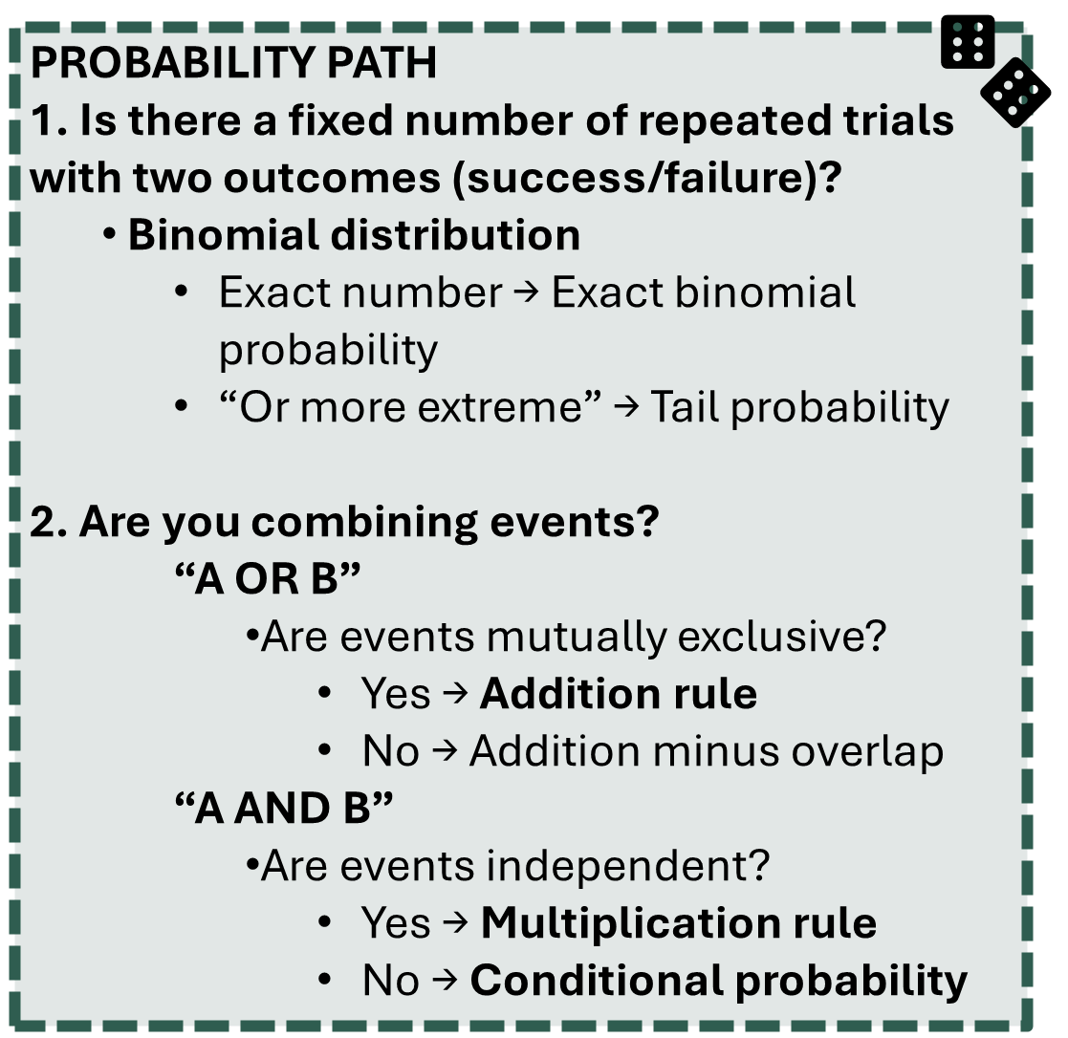
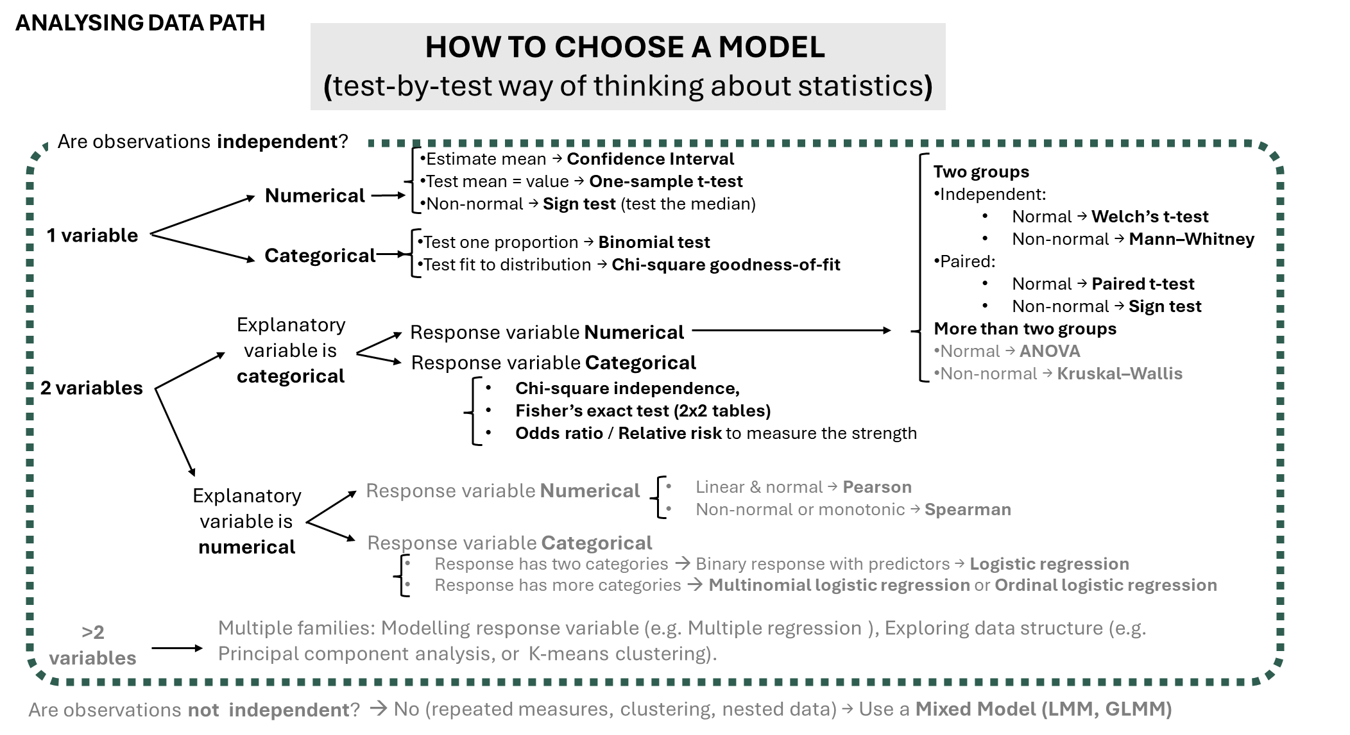
Are you calculating a probability or analysing collected data?
Notes:
First check if observations are independent. If observations are not independent (for example repeated measures, clustering or nested data) use a mixed model. If observations are independent we will check if we have one variable, two variables ore more than two.
If one variable: check if the variable is numerical or categorical. If its numerical: if you want to estimate the mean obtain confidence intervals, if you want to test the mean do a one sample t-test. If data is not normal apply sign test. If the data is categorical and you want to test a proportion use the binomial test. If you need to fit a distribution use the chi-square goodness-of-fit
If two variables: divide between Explanatory variable categorical and explanatory variable numerical.
Explanatory variable categorical: we have two options, response variable being numerical and being categorical. If response variable is numerical we will check the number of groups. If we have two groups and those are independent we will apply the welch’s test for normal data and the Mann-Whitney test for non-normal data. If the two groups are paired we will apply the paired t-test if the data is normal and the sign test if not. If we have more than two groups we will apply ANOVA if the data is normal and Kruskal-wallis if it is non normal. If the response variable is categorical we will use the chi-square test of independence or the Fisher’s exact test if the n is small, and the Odds ratio or relative risk to measure the association strength.
Explanatory variable numerical. If the response variable is numerical we will use linear regression for linear relationships, non-linear models for non-linear relationships. Pearson for linear and normal data and Spearman for non-normal data. If the response variable is categorical we will check the number of categories. If the response has two categories we will use logistic regression. If the response has more than two categories we will use multinomial logistic regression or ordinal logistic regression.
If more than two variables: examples of applied techniques can be Multiple regression (linear, non-linear, logistic…), Principal component analysis or K-means clustering

Slide 30
Are you calculating a probability or analysing collected data?
Notes:
First check if observations are independent. If observations are not independent (for example repeated measures, clustering or nested data) use a mixed model. If observations are independent we will check if we have one variable, two variables ore more than two.
If one variable: check if the variable is numerical or categorical. If its numerical: if you want to estimate the mean obtain confidence intervals, if you want to test the mean do a one sample t-test. If data is not normal apply sign test. If the data is categorical and you want to test a proportion use the binomial test. If you need to fit a distribution use the chi-square goodness-of-fit
If two variables: divide between Explanatory variable categorical and explanatory variable numerical.
Explanatory variable categorical: we have two options, response variable being numerical and being categorical. If response variable is numerical we will check the number of groups. If we have two groups and those are independent we will apply the welch’s test for normal data and the Mann-Whitney test for non-normal data. If the two groups are paired we will apply the paired t-test if the data is normal and the sign test if not. If we have more than two groups we will apply ANOVA if the data is normal and Kruskal-wallis if it is non normal. If the response variable is categorical we will use the chi-square test of independence or the Fisher’s exact test if the n is small, and the Odds ratio or relative risk to measure the association strength.
Explanatory variable numerical. If the response variable is numerical we will use linear regression for linear relationships, non-linear models for non-linear relationships. Pearson for linear and normal data and Spearman for non-normal data. If the response variable is categorical we will check the number of categories. If the response has two categories we will use logistic regression. If the response has more than two categories we will use multinomial logistic regression or ordinal logistic regression.
If more than two variables: examples of applied techniques can be Multiple regression (linear, non-linear, logistic…), Principal component analysis or K-means clustering

Slide 31
Are you calculating a probability or analysing collected data?
Notes:
First check if observations are independent. If observations are not independent (for example repeated measures, clustering or nested data) use a mixed model. If observations are independent we will check if we have one variable, two variables ore more than two.
If one variable: check if the variable is numerical or categorical. If its numerical: if you want to estimate the mean obtain confidence intervals, if you want to test the mean do a one sample t-test. If data is not normal apply sign test. If the data is categorical and you want to test a proportion use the binomial test. If you need to fit a distribution use the chi-square goodness-of-fit
If two variables: divide between Explanatory variable categorical and explanatory variable numerical.
Explanatory variable categorical: we have two options, response variable being numerical and being categorical. If response variable is numerical we will check the number of groups. If we have two groups and those are independent we will apply the welch’s test for normal data and the Mann-Whitney test for non-normal data. If the two groups are paired we will apply the paired t-test if the data is normal and the sign test if not. If we have more than two groups we will apply ANOVA if the data is normal and Kruskal-wallis if it is non normal. If the response variable is categorical we will use the chi-square test of independence or the Fisher’s exact test if the n is small, and the Odds ratio or relative risk to measure the association strength.
Explanatory variable numerical. If the response variable is numerical we will use linear regression for linear relationships, non-linear models for non-linear relationships. Pearson for linear and normal data and Spearman for non-normal data. If the response variable is categorical we will check the number of categories. If the response has two categories we will use logistic regression. If the response has more than two categories we will use multinomial logistic regression or ordinal logistic regression.
If more than two variables: examples of applied techniques can be Multiple regression (linear, non-linear, logistic…), Principal component analysis or K-means clustering

Slide 32
Are you calculating a probability or analysing collected data?
Notes:
First check if observations are independent. If observations are not independent (for example repeated measures, clustering or nested data) use a mixed model. If observations are independent we will check if we have one variable, two variables ore more than two.
If one variable: check if the variable is numerical or categorical. If its numerical: if you want to estimate the mean obtain confidence intervals, if you want to test the mean do a one sample t-test. If data is not normal apply sign test. If the data is categorical and you want to test a proportion use the binomial test. If you need to fit a distribution use the chi-square goodness-of-fit
If two variables: divide between Explanatory variable categorical and explanatory variable numerical.
Explanatory variable categorical: we have two options, response variable being numerical and being categorical. If response variable is numerical we will check the number of groups. If we have two groups and those are independent we will apply the welch’s test for normal data and the Mann-Whitney test for non-normal data. If the two groups are paired we will apply the paired t-test if the data is normal and the sign test if not. If we have more than two groups we will apply ANOVA if the data is normal and Kruskal-wallis if it is non normal. If the response variable is categorical we will use the chi-square test of independence or the Fisher’s exact test if the n is small, and the Odds ratio or relative risk to measure the association strength.
Explanatory variable numerical. If the response variable is numerical we will use linear regression for linear relationships, non-linear models for non-linear relationships. Pearson for linear and normal data and Spearman for non-normal data. If the response variable is categorical we will check the number of categories. If the response has two categories we will use logistic regression. If the response has more than two categories we will use multinomial logistic regression or ordinal logistic regression.
If more than two variables: examples of applied techniques can be Multiple regression (linear, non-linear, logistic…), Principal component analysis or K-means clustering

